Slide 1

CSYE 6200
Daycare Project
Group 5
By-
Ishita Sanjay Janwale - 002743825
Amisha Gokhale- 002743313
Vaishnavi Bhoite- 002776319
Cyrus Dbritto - 002922815
Ayushi Patel - 002925618
Pinkle Soni- 002928259
Here is where
ur presentation begins

Slide 2
Table of contents
01
02
03
04
05
06
07
Flow of the Model
Introduction
Tools and Technologies
Screenshots of Project
Learnings Outcomes
Future Scope
Contributions

Slide 3
Introduction
01
Our project was to develop DayCare Model using the different Object-oriented principles and patterns, and as as part of our project, we did following:
Student enrollment and getting data.
Tracking the Student Registration and immunization history.
Usage of Design patterns like Singleton, Factory and MVC design patterns.
Grouping the Students and Teachers to different classrooms with ratio.
Tracking all entities through CSV files.
Using database for data entry.
Implementing the model with the Swing GUI using different entities
Tracking the annual employee review.
Alerts of overdue dates of immunization of students.

Slide 4
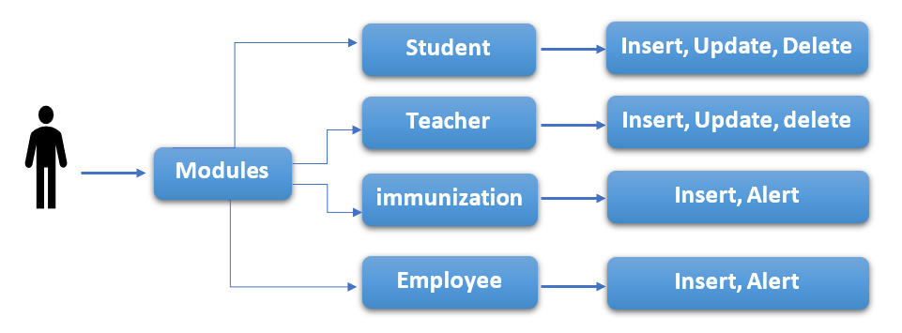
Flow Chart
USER

Slide 5
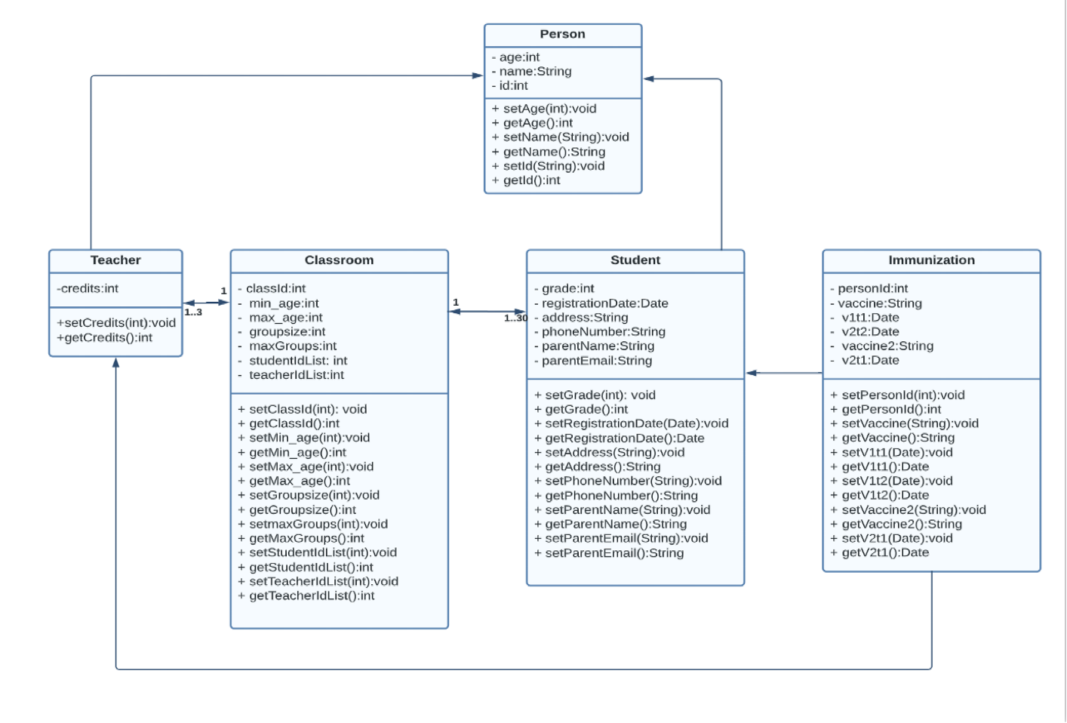
UML

Slide 6
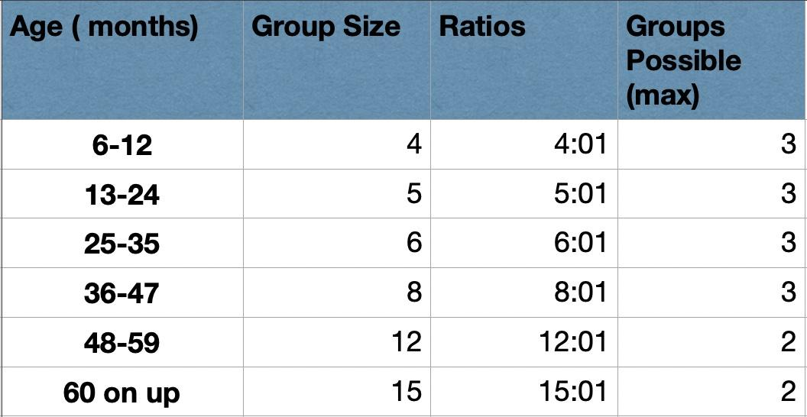
GROUPING

Slide 7
Tools & Technologies
Technologies Used
Tools Used
H2 Embedded DB
Java Spring Boot
Java Swing
Java
Design Patterns Used:
Singleton Design Pattern, Model View Controller Design Pattern, Factory Design Pattern, Streams
Eclipse IDE
Netbeans
Maven

Slide 8
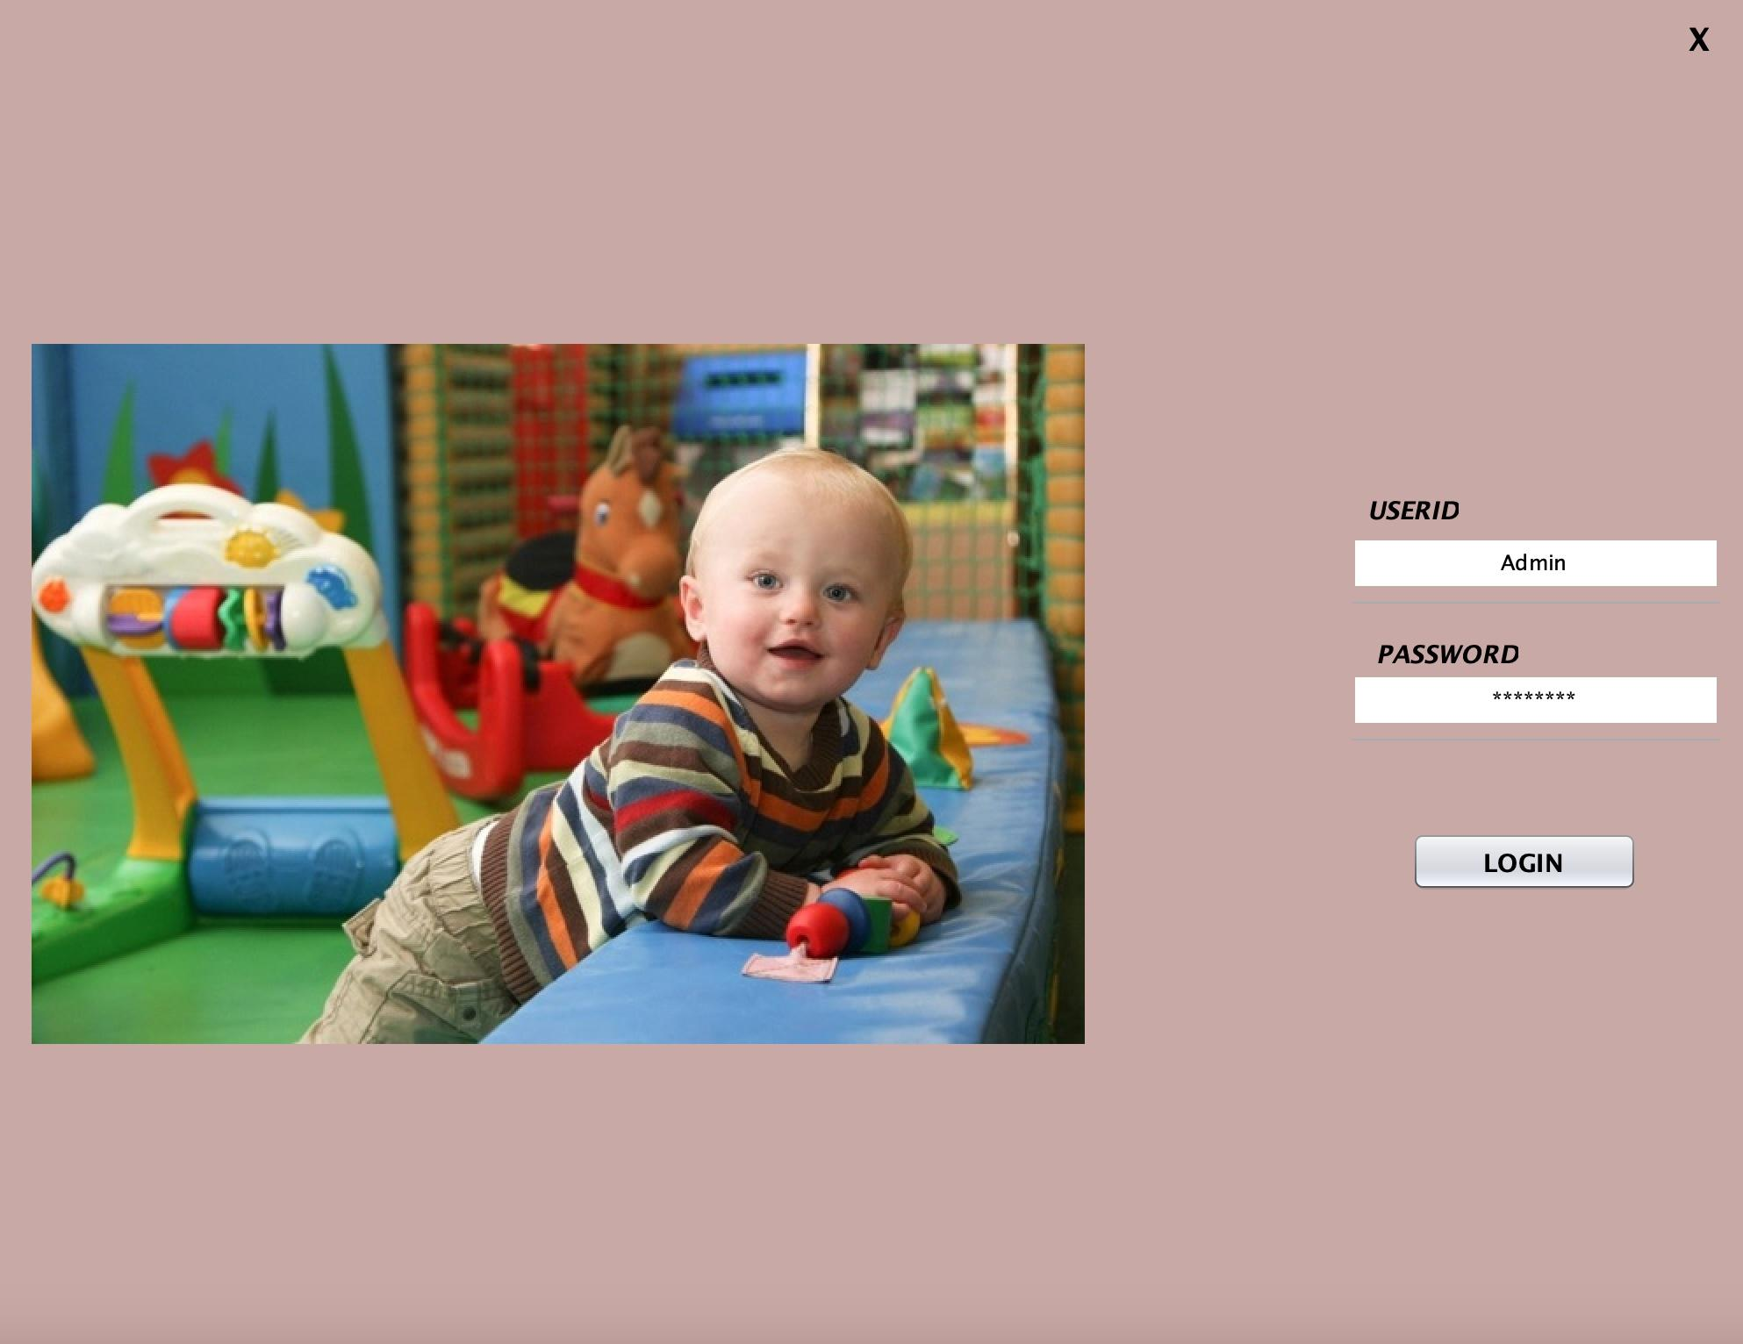
MainFrame

Slide 9
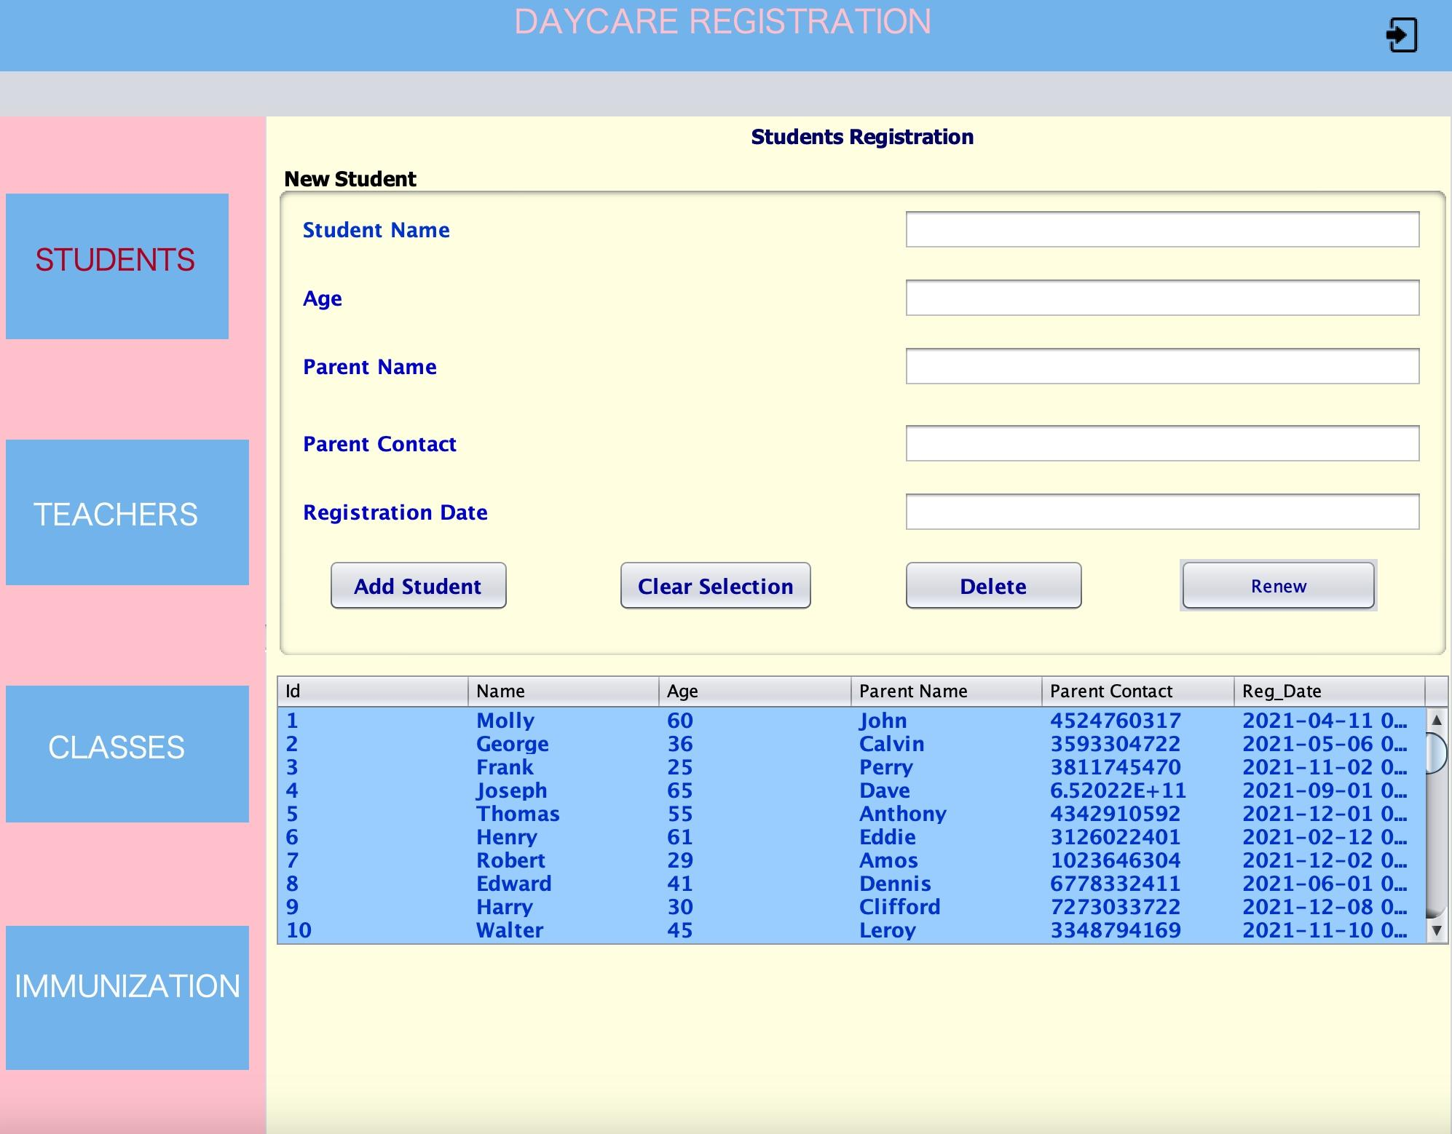
Student Registration

Slide 10
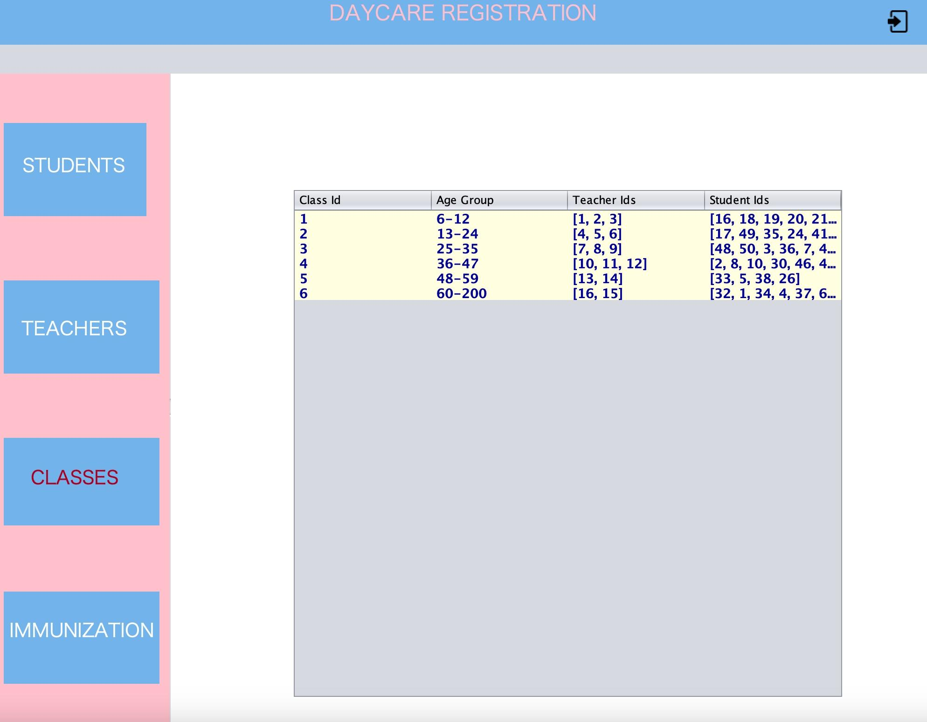
Classes Registration

Slide 11
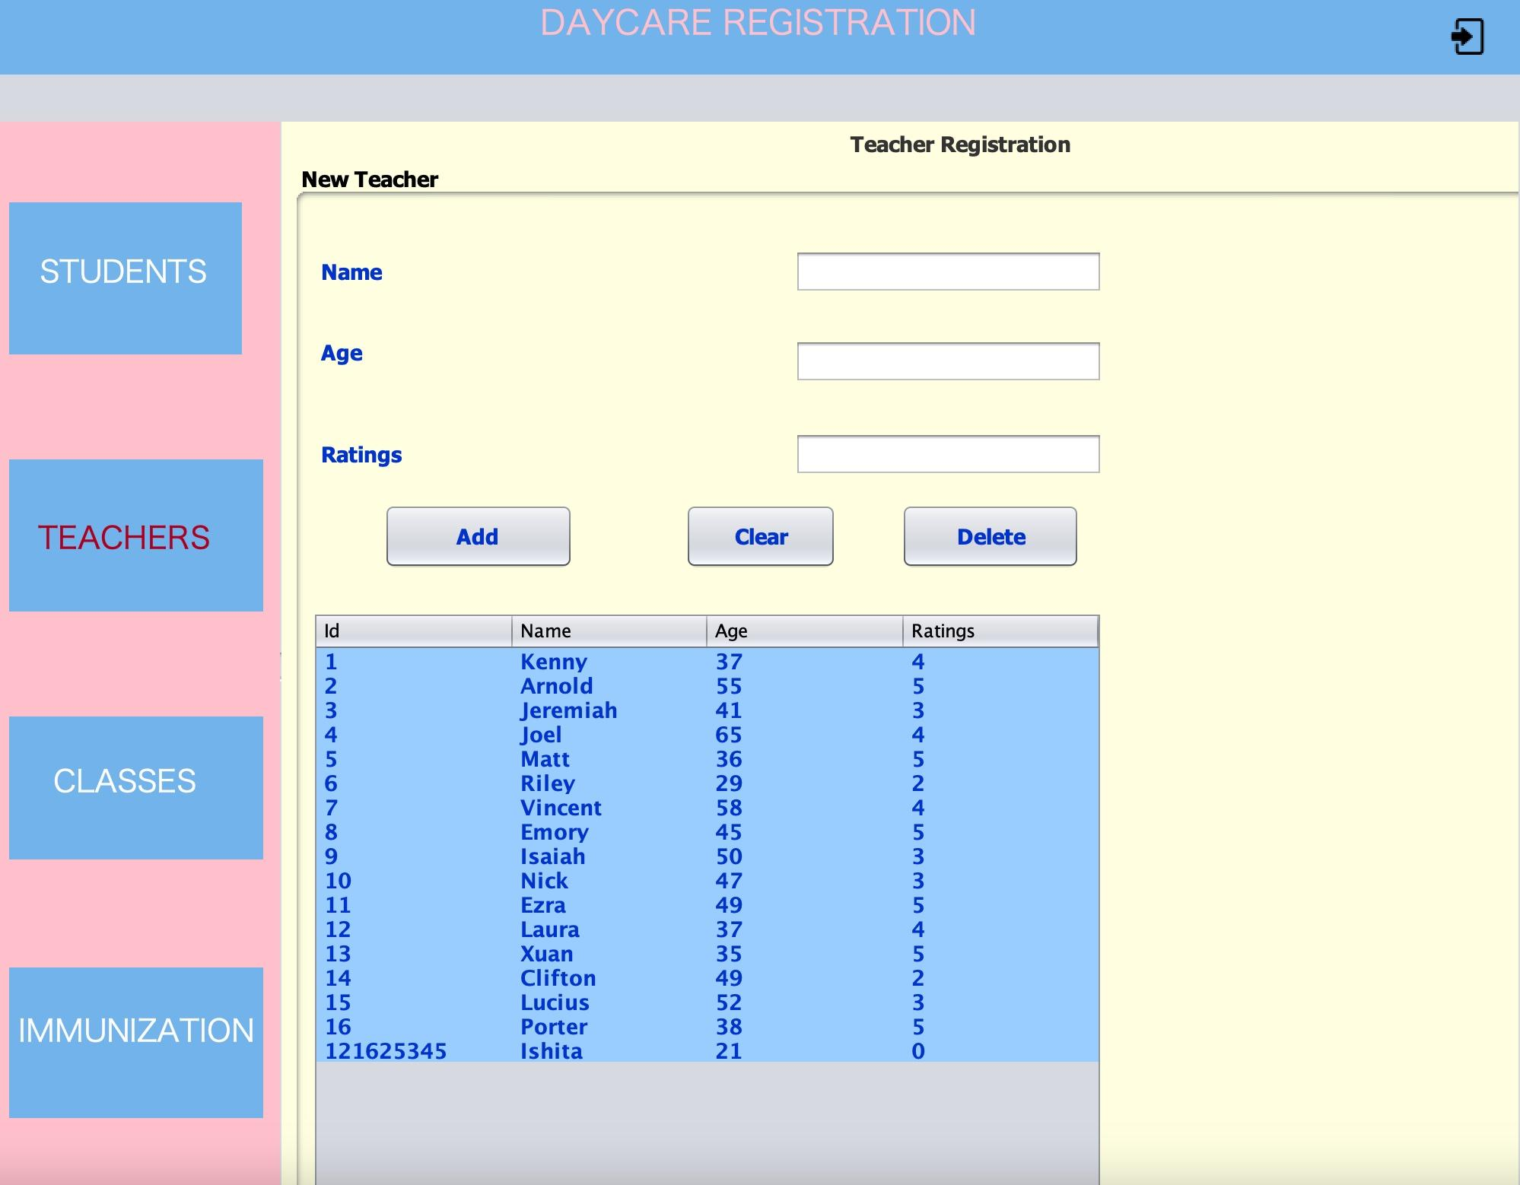
Teacher Registration

Slide 12
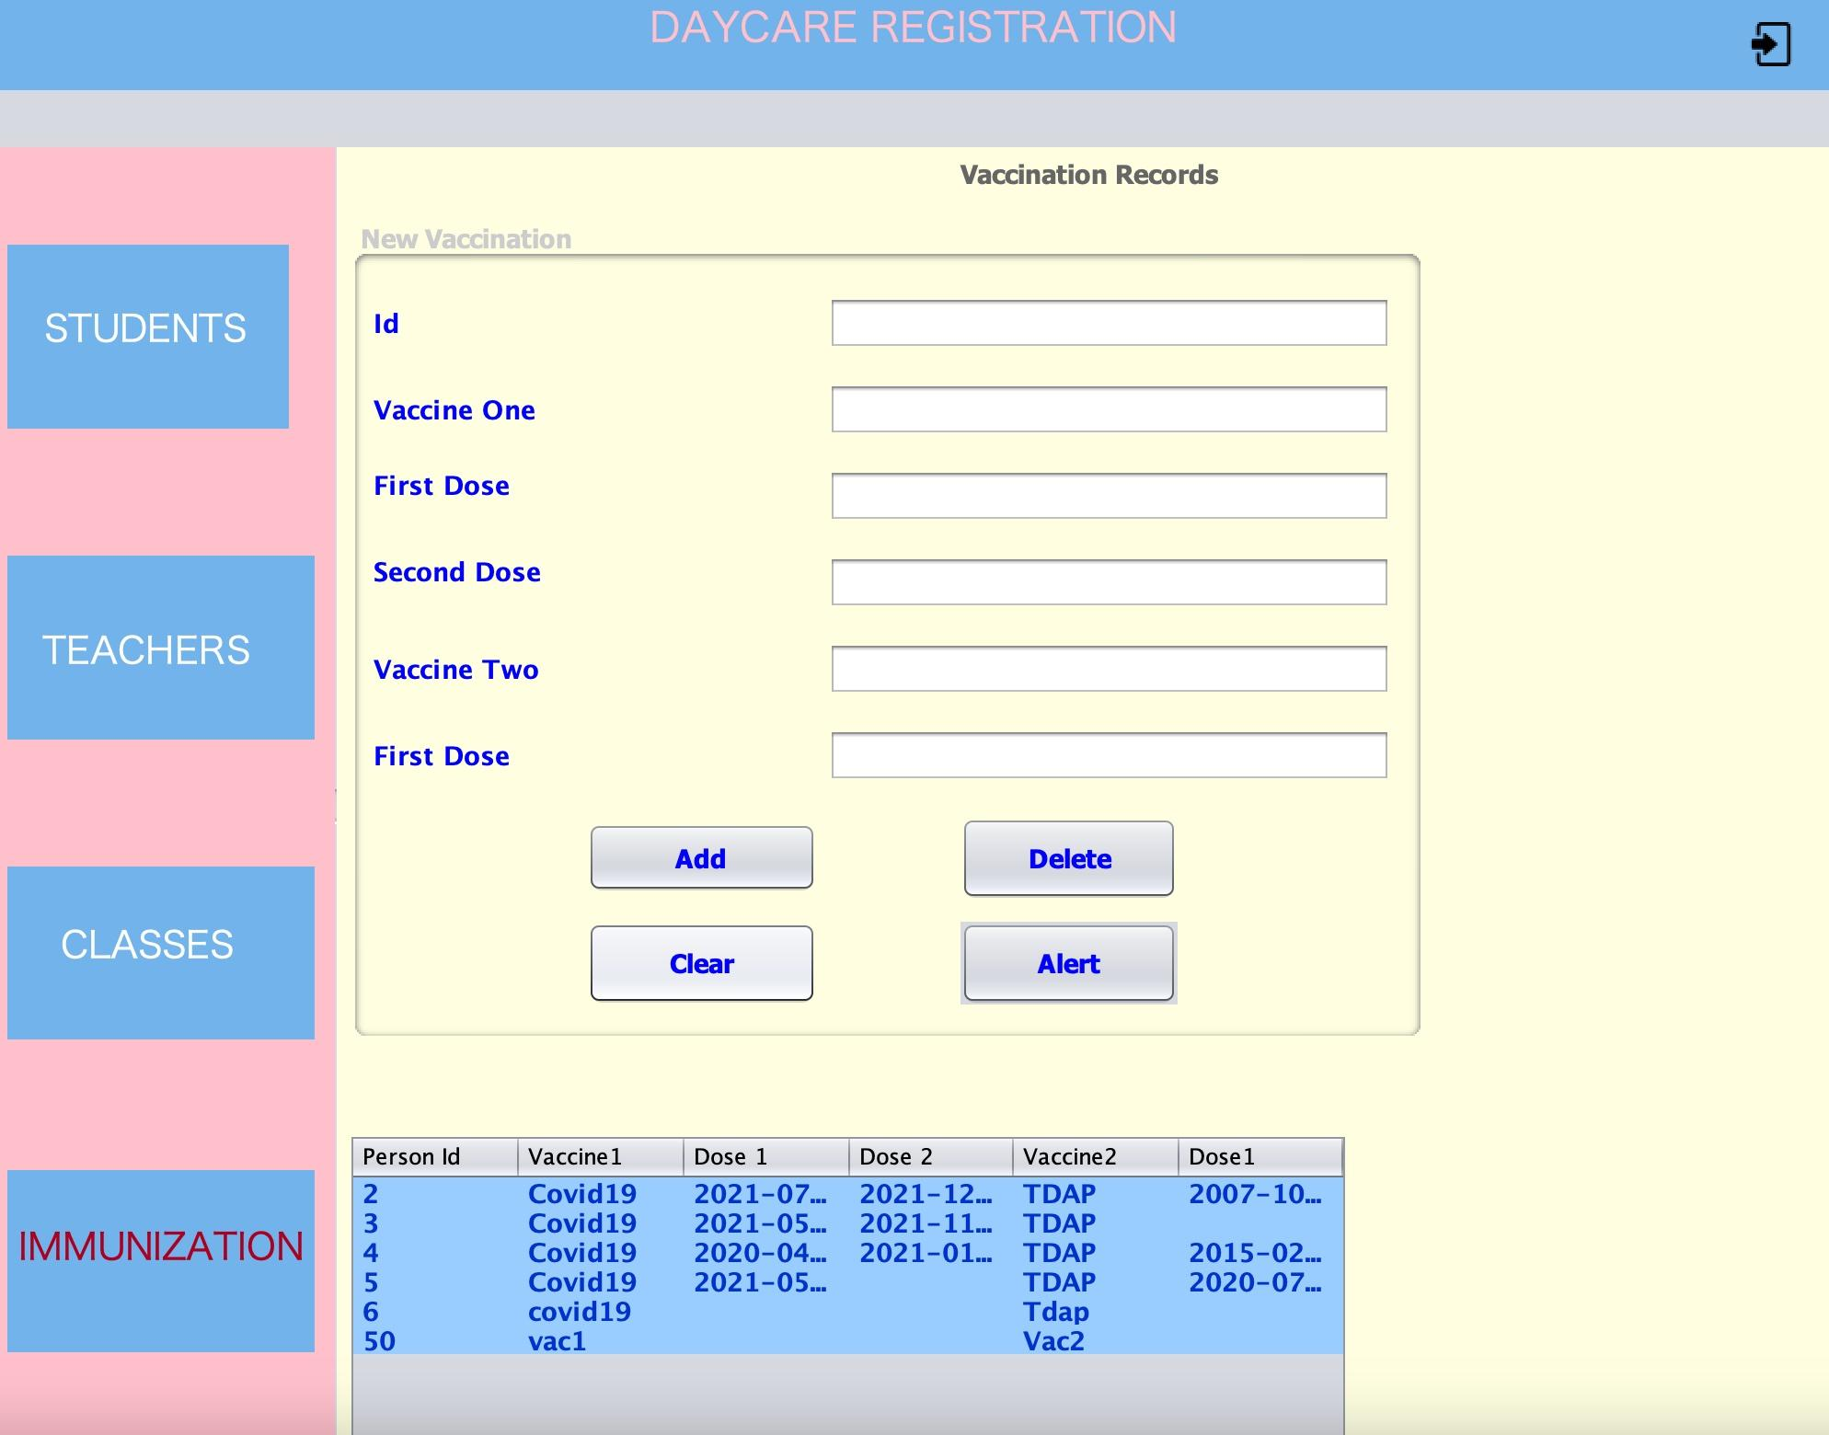
Immunization Registration

Slide 13
Learning Outcomes
Through the course of the project we learnt:
Usage of Swing GUI for the daycare model.
Understanding of Spring boot functionality and backend implementation.
Understanding the dependencies clearly.
DB implementation and building CRUD application.
Able to learn and implement MVC and Factory Design Patterns along with different OOPS principles .

Slide 14
Future Enhancements
Health care physicians can be involved in it.
Improvise modules to handle latency
Usage of cloud hosting platform and enhanced encryption
Can be developed interactive statistical analysis on the clinical data using Teacher and Students.
Real-time notifications can be added.
With emerging technologies like React Native and others, the UI can be more interactive and captivating.

Slide 15
Contribution
Name | Contribution
Cyrus Dbrito | Testing (UI, BE) and Reporting, Factory Patterns for object creation, Backend: BE logic for persons.
Ayushi Patel | Swing UI - classes pane, BE integration, backend spring integration,frontend Database and Backend: Classroom, Backend spring integration.
Pinkle Soni | Wireframing, Frontend: Swing UI – classes pane, BE integration, frontend Database and Backend: Student JTable.
Ishita Sanjay Janwale | Frontend and Backend: Teacher JTable, SpringBoot, DB Integration, Testing (UI, BE) and Reporting, Bug fixes.
Vaishnavi Bhoite | Integration and Backend: Swing UI vaccinations, BE integration, alert notifications.
Amisha Gokhale | Backend: BE logic for classes ratio and Testing, backend: Immunization backend, Factory pattern for object creation.

Slide 16
THANK YOU

